Slide 1

NETWORK PROTOCOLS
Shashikumara AA
School of Library and Information Science
Central University of Gujarat
4th October, 2017

Slide 2

Contents
What is a Network? - Types, Network Topology
What is Protocols? - Need for Protocols
OSI Reference Model
Transmission Control Protocol/Internet Protocol (TCP/IP)
File Transfer Protocol (FTP)
Simple Mail Transfer Protocol (SMTP)
Hypertext Transfer Protocol (HTTP)
Secure Hypertext Transfer Protocol (HTTPS)
Secure Shell (SSH)
Simple Object Access Protocol (SOAP)

Slide 3

A network consists of two or more computers that are linked in order to share resources, exchange files, or allow electronic communications. . The computers on a network may be linked through cables, telephone lines, radio waves, satellites, or infrared light beams.
What is a Network?

Slide 4
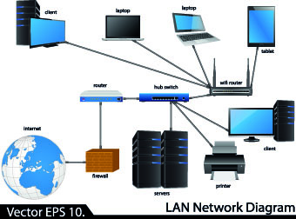
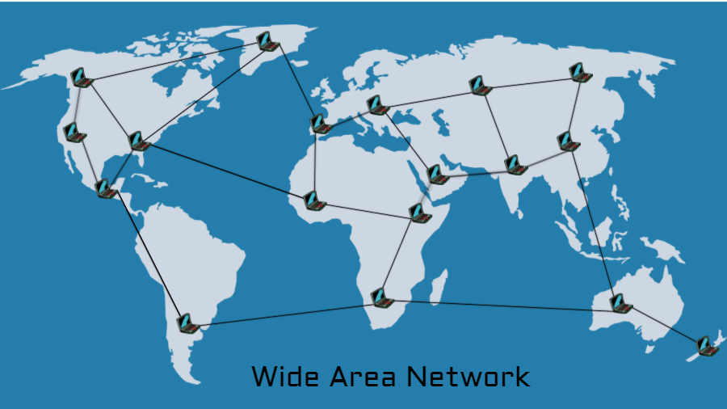
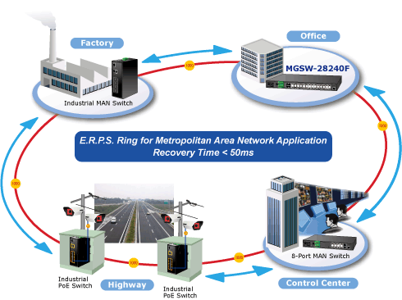
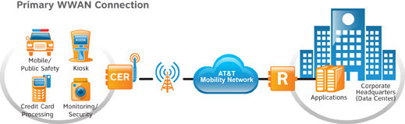
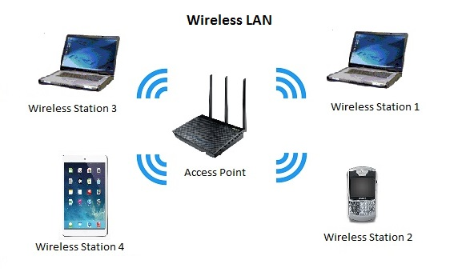
Types of Networks
Local Area Network (LAN)
Wide Area Network (WAN)
Metropolitan Area Networks (MAN)
Wireless LAN (WLAN)
Wireless WAN (WWAN)

Slide 5
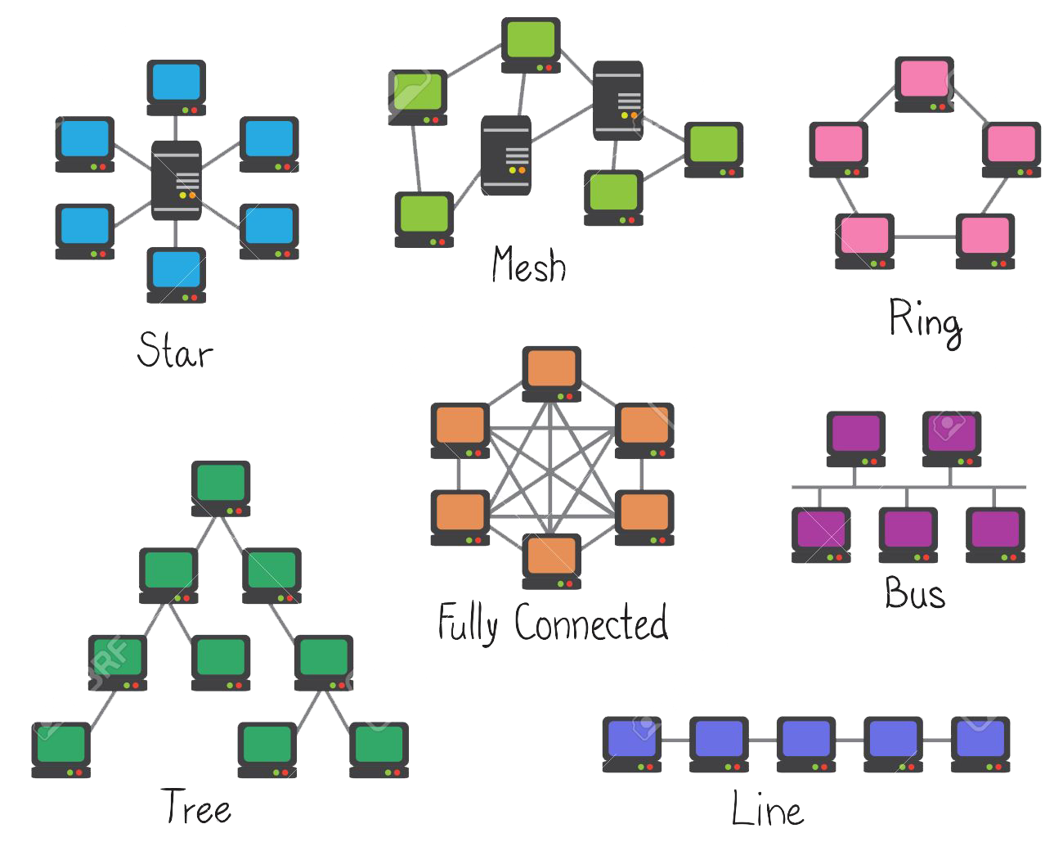
Network Topology

Slide 6
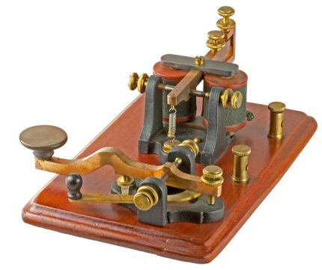
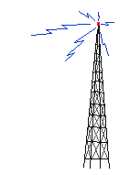





What is Protocol
Communication protocols are agreed sets of rules and procedures for computers to exchange information.
Like humans agreeing to speak the same language during a conversation.
For two computers to exchange data, they must be using the same protocols.
If we both utilize the same protocol then you know how to format data so I will understand it and I know how to format data so you will understand it
Notes:
during a phone call, saying “Uh huh”, “Mmmm” or “Yeah” while the other person speaks
nodding to show understanding
waiting for the other person to stop talking before you start
raising pitch of voice after a question
airline pilots speak English, refer to heights in feet, agree on which direction to turn to avoid collision, pronounce 9 as “niner”, spell out letters with words

Slide 7
If we both utilize the same protocol
then you know how to format data
so I will understand it
and I know how to format data
so you will understand it

Slide 8

Need for Protocols
Need a standard means of communication between devices
Can’t communicate if speaking two different languages
Protocols are needed for predetermined understandings for communications
It helps the smooth functioning of a system, such contribution to a system may benefit or offend you from where you stand
Therefore we have a concept called “Protocol”

Slide 9
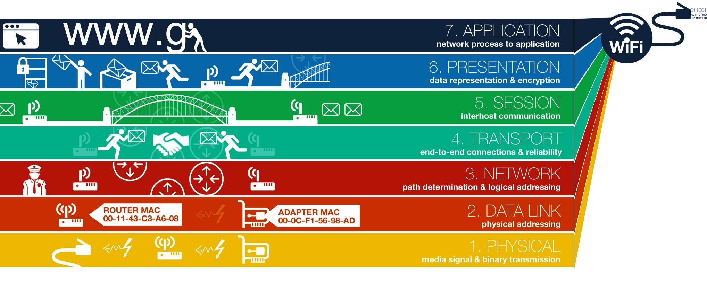
Open System Interconnection (OSI) Reference Model

Slide 10
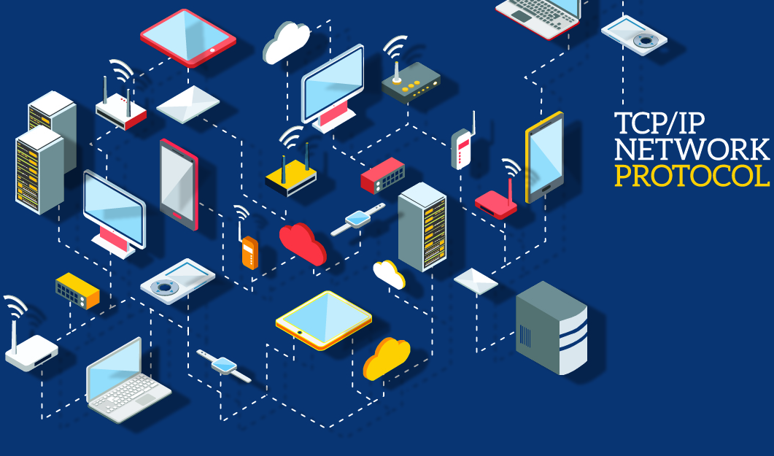

Slide 11
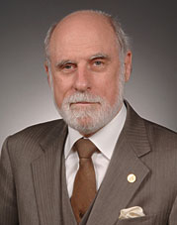

Transmission Control Protocol/ Internet Protocol (TCP/IP)
TCP/IP is a suite of communication protocols used to interconnect network devices on the internet.
The most popular network protocol in the world,
TCP/IP protocol suite, was designed in 1970s by 2 DARPA scientists Vint Cerf & Bob Kahn, persons most often called the fathers of the Internet.
TCP/IP can also be used as a communications protocol in a private network (an intranet or an extranet).

Slide 12
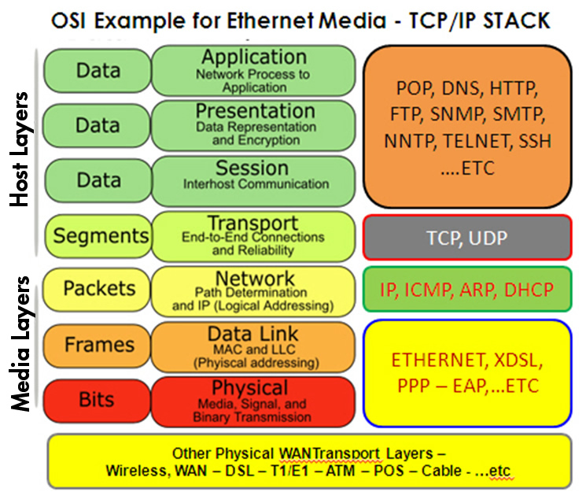
OSI Example for Ethernet Media - TCP/IP Stack

Slide 13
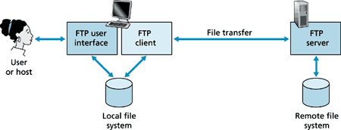
File Transfer Protocol (FTP)
FTP is the standard, simplest and most secure way to exchange files over the Internet.
Transferring files from a client computer to a server computer is called uploading and transferring from a server to a client is downloading.
To access an FTP server, users must be able to connect to the Internet or an intranet with an FTP client program.

Slide 14
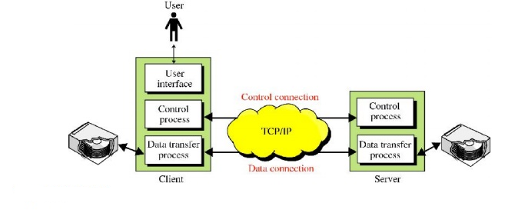
How FTP works

Slide 15





FTP Clients
FileZilla - a popular FTP client that is freely available for Windows, Macintosh, and Linux users Available as a free download from the Internet.
Fire FTP - a plug-in for the popular Firefox web browser that can be used just like a standalone FTP program Installed through the FireFox browser.
Classic FTP - an easy and reliable FTP client for file sharing or website maintenance, to upload, download, transfer and backup files on your computer.
WinSCP- WinSCP is a free SFTP and FTP client for Windows, and a multi-functional tool that improves your productivity. WinSCP copies files between and remote computers using multiple protocols: FTP, FTPS, SCP, SFTP, or WebDAV. And WinSCP offers an intuitive interface.
Cyberduck - Cyberduck is an open source client for FTP and SFTP, WebDAV, and cloud storage, available for macOS and Windows licensed under the GPL.

Slide 16
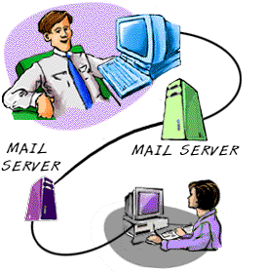
Simple Mail Transfer Protocol (SMTP)
Simple Mail Transfer Protocol (SMTP) is a standard communication protocol for sending email messages on business networks and the Internet.
SMTP was originally developed in the early 1980s and remains one of the most popular protocols in use worldwide.
Email software most commonly uses SMTP for sending and either the Post Office Protocol 3 (POP3) or Internet Message Access Protocol (IMAP) protocols for receiving mail.

Slide 17
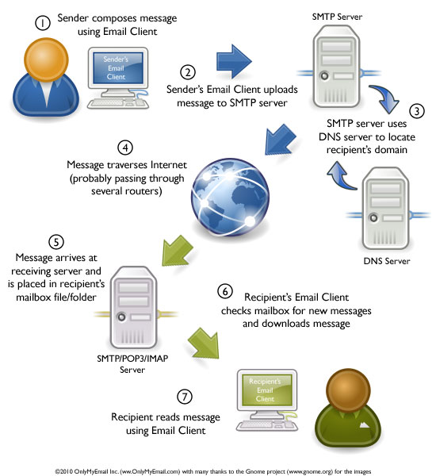
How Email Works

Slide 18





SMTP Clients
eM Client: eM Client is a full featured e-mail client with a modern and easy to use interface. eM Client also offers calendar, tasks, contacts and chat.
Mailbird Lite: Mailbird is a desktop email client for your Windows PC. It is packed with apps, features, shortcuts and software upgrades.
Claws Mail: Claws Mail is a free and open-source, GTK+-based email and news client. It offers easy configuration and an abundance of features. It runs on both Windows and Unix-like systems such as Linux, BSD, Solaris.
Opera Mail: Opera Mail is a lightweight, customizable mail client.
Mozilla Thunderbird: Thunderbird is a free email application that's easy to set up and customize - and it's loaded with great features.

Slide 19


Hypertext Transfer Protocol (HTTP)
Sir Tim Berners-Lee invented the World Wide Web in 1989.
HTTP is the set of rules for transferring files (text, graphic images, sound, video, and other multimedia files) on the World Wide Web.
As soon as a Web user opens their Web browser, the user is indirectly making use of HTTP.
HTTP is an application protocol that runs on top of the TCP/IP suite of protocols (the foundation protocols for the Internet).

Slide 20
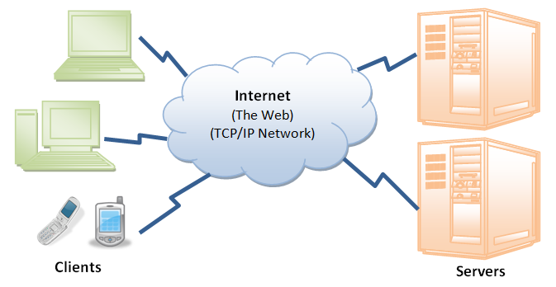
How HTTP Works

Slide 21


Secure Hypertext Transfer Protocol (HTTPS)
HTTPS is the secure version of HTTP, the protocol over which data is sent between the browser and the website that you are connected to.
The 'S' at the end of HTTPS stands for 'Secure'.
It means all communications between the browser and the website are encrypted.
HTTPS is often used to protect highly confidential online transactions like online banking & online shopping order forms.
Web browsers such as Internet Explorer, Firefox & Chrome also display a padlock icon in the address bar to visually indicate that a HTTPS connection is in effect.

Slide 22
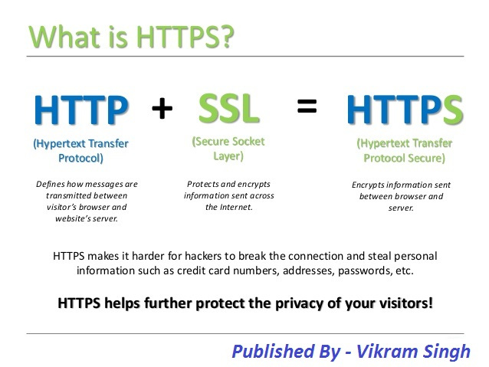
HTTPS Explained

Slide 23
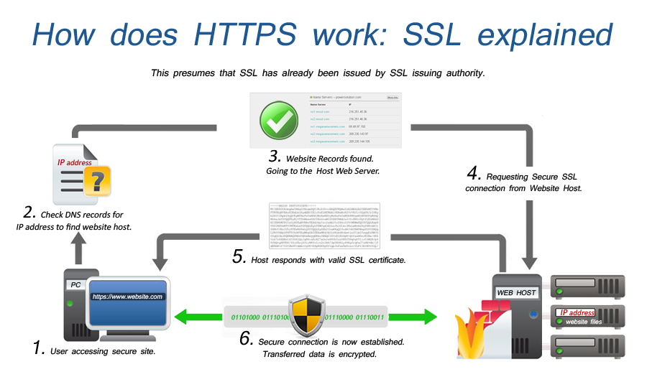
How does HTTPS work: SSL explained

Slide 24
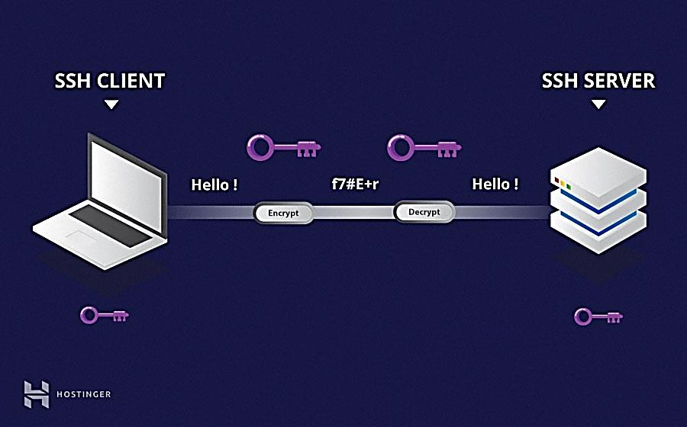
Secure Shell (SSH)
SSH, also known as Secure Socket Shell, is a network protocol that provides administrators with a secure way to access a remote computer.
The best known example application is for remote login to computer systems by users.
SSH provides strong authentication and secure encrypted data communications between two computers connecting over an insecure network such as the Internet.
SSH is widely used by network administrators for managing systems and applications remotely, allowing them to log in to another computer over a network, execute commands and move files from one computer to another.

Slide 25
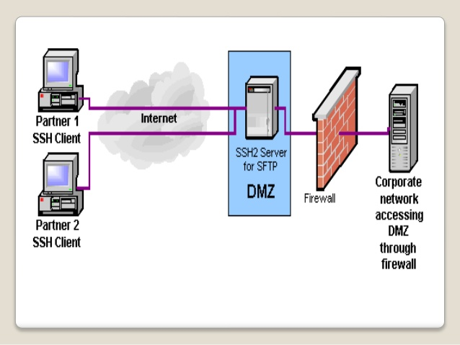
SSH Architecture

Slide 26
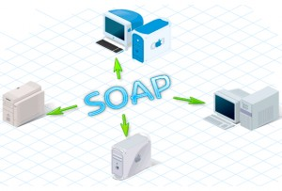
Simple Object Access Protocol (SOAP)
Communication protocol
For communication between applications
A format for sending messages
Is designed to communicate via Internet
Platform independent
Language independent
Based on XML
Simple and extensible

Slide 27
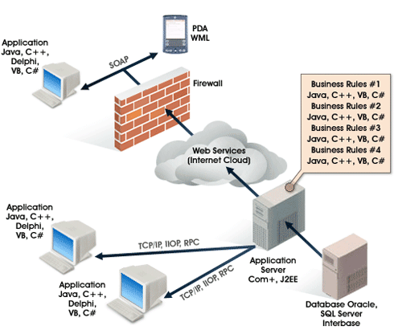
SOAP protocol explained

Slide 28
References
Alani, M. M. (2014). Guide to OSI and TCP/IP Models. Cham: Springer International Publishing. https://doi.org/10.1007/978-3-319-05152-9
Cardwell, K. (2016). Network Protocols. In Essential Skills for Hackers (pp. 1–5). Elsevier. https://doi.org/10.1016/B978-0-12-804755-2.00001-6
Communications protocol, https://en.wikipedia.org/wiki/Communications_protocol
Cowley, J. (2013). Network Protocols. In J. Cowley, Communications and Networking (pp. 81–109). London: Springer London. https://doi.org/10.1007/978-1-4471-4357-4_6
Encryption is not the same as security – Please take note https://www.webscreationsdesign.com/encryption-is-not-the-same-as-security-please-take-note/
File Transfer Protocol (FTP) http://www.brainkart.com/article/File-Transfer-Protocol--FTP-_13494/
Goralski, W. (2017). The illustrated network: how tcp/ip works in a modern network (2nd edn). Cambridge, MA: Elsevier.
Introduction To OSI Model https://teamultimate.in/osi-model/
Lists of network protocols, https://en.wikipedia.org/wiki/Lists_of_network_protocols
OSI model – how Internet works http://www.gargasz.info/osi-model-how-internet-works/
Wilde, E. (1999). Wilde’s WWW. Berlin, Heidelberg: Springer Berlin Heidelberg. https://doi.org/10.1007/978-3-642-95855-7
Network Protocols - https://www.youtube.com/watch?v=QrNnRJqTMO8&t=2s
Communications protocol - https://en.wikipedia.org/wiki/Communications_protocol
Network topologies - https://www.youtube.com/watch?v=F35sSPTahS8&t=2s
Understanding the OSI Reference Model: Cisco Router Training 101 - https://www.youtube.com/watch?v=sVDwG2RdJho&t=65s

Slide 29
Acknowledgement
Dr. Muttayya K., Professor, School of Library &Information Science, CUG
Dr. K.B. Agadi, Assistant Librarian, Central University of Gujarat.
Faculty Members & Students, School of Library &Information Science, CUG

Slide 30
Thank You!
Any questions?

